Slide 1
Extreme Programming
> an agile methodology <
Mark Kilby / SAIC
Steve Raulerson & Matt Weber
/ CONVERGYS
June 2002

Slide 2
Traditional Software Methodologies
Seek to avoid chaotic “code & fix” approach
Impose a disciplined process on software development
Goal is to make development more efficient and predictable
Strong emphasis on “planning” inspired by engineering disciplines

Slide 3
Reality Check…deviations from the plan
Testing and Documentation slip first when the going gets tough
Requirements ALWAYS change
  Business environment can change during software development
Developers want to build FLEXIBILITY into the system to anticipate future needs of the customer
  Usually more flexibility than the customer requested
EVERYONE WANTS QUALITY: Customer, PM, senior management and (especially) developers
Most developers and managers try to sidestep or manipulate the bureaucracy & complexity of the process

Slide 4
So, Agile Methodologies ask… ^{[1]}
If design is good, why not make it everyone’s job?
If simplicity is good, why not use the simplest design that supports the currently desired functionality?
If architecture is good, why not have everyone work at defining and refining the architecture continuously?
If short iterations are good, why not make iterations really short (hours and days) instead of weeks and months?
If requirements, design, and code reviews are good, why not do it all the time?
If testing is good, why not do it all the time… even customers?
If integration testing is good, why not do it several times a day?

Slide 5
Agile Methodologies
Seek to address these questions and the “realities” of software development
Maintain a repeatable, quality-driven process
Properties of an Agile Methodology:
  Iterative development
    Short iterations (2-6 weeks)
    Working versions at conclusion of each iteration
    Fully integrated and tested
  Adaptable: can evolve with each iteration
  People-centric: developers & management equal

Slide 6
Agile Methodologies - Examples
SCRUM
Dynamic Systems Development Method (DSDM)
  Popular in UK; 9 practices similar to XP; being adopted by UK government
Crystal Family & Adaptive Software Development (merged in 2001)
Feature-Driven Development (FDD – Coad)
Pragmatic Programming
dX (agile form of RUP)
Extreme Programming (XP)
For an overview of agile methodologies, see [2]

Slide 7
Extreme Programming (XP)
Receives the most press (or hype)
Like most agile methodologies, use for…
  Small to medium-sized team (up to 30?)
  High risk projects
  Vague or rapidly changing requirements
Adopts processes from other methodologies
  E.g., SCRUM, Crystal
Used or experimented with at…
  Daimler-Chrysler, Ford, Capital One, IBM, and many others

Slide 8
Why XP? > revisit Reality Checks > a.k.a. Risks
Schedule Slips
Projects canceled
Defect rates
Business misunderstood
Business changes
Unnecessary functionality
Staff turnover
Lack of Discipline?
  Coding standards: How well are they followed?
  Code reviews: Are they effective?

Slide 9
XP > 4 Values
Simplicity
  Do the simplest thing that works for the current business need
  Hardest value for most software engineers to accept
Communication
  Choose practices that will work better support communication
  At all levels: unit testing, pair programming, estimation
Feedback …at all levels and timescales
  Minutes, days, weeks: unit tests, functional tests, early production
  Scope: as soon as customer writes a user story, a developer estimates
Courage
  To rework design and code when needed
  To throw away code when no longer needed
  Without other 3 values, you’re just “hacking”

Slide 10
XP > Practices
The 4 Values drive the practices:
  Simplicity, Feedback, Communication, Courage
  Think of them as “maximizing functions”
Practice = Etude ^{[3]}
  In music, an etude is a piece of music practiced repeatedly to perfect a technique
  You may not use all the practices all the time on every project…
  …but repeated use of the XP Practices will make better software engineers out of your team and get you to a solution faster
Practices work best when used together (SYNERGY)

Slide 11
XP > Practices > “Circles of Life” ^{[4]}
On-site Customer
Coding_x000b_Standards
Metaphor
Refactoring
Customer – Team – Developer Pair – Team – Customer
Acceptance_x000b_Tests
Unit Tests
Pair _x000b_Programming
Release_x000b_Planning
Continuous_x000b_Integration
Collective_x000b_Ownership
Simple Design
Sustainable_x000b_Pace
Synergy >
Small Releases
Notes:
Different Roles within the Extreme Programming methodology work with some of the practices more than others. This “Circle of Life” diagram (adapted from Ron Jefferies papers on XP) shows how the customer is more involved with the “outer ring” practices, the team is involved in all practices, and developers, or pairs of developers are involved in some of the “inner ring” practices.

Slide 12
XP > Practices > “Circles of Life” ^{[4]}
On-site Customer
Coding
Standards
Metaphor
Refactoring
Customer – Team – Developer Pair – Team – Customer
Acceptance
Tests
Unit Tests
Pair
Programming
Release
Planning
Continuous
Integration
Collective
Ownership
Simple Design
Sustainable
Pace
Synergy >
Small Releases

Slide 13
XP > Practices > On-Site Customer(s)
Empowered to determine requirements, define functionality, set priorities, and answer questions for the programmers
Daily, face-to-face customer interaction should…
  reduce the amount of hard-copy documentation
  and the high cost associated with its creation and maintenance
< back 2 COL

Slide 14
XP > Practices > Release Planning
a.k.a. “Planning Game”
Requires the XP "customer" to define the business value of desired features
  User Stories
Programmers (not just PM) provide cost estimates for those features
Using this information, customer and developers perform a cost/benefit analysis of each feature
  enables them to make intelligent decisions about which features to implement and which to defer
< back 2 COL

Slide 15
XP > Practices > Small Releases
Put a simple system into production quickly, then release new versions on a very short cycle
For example
  Release might be 2-3 months
  Each release might have multiple 2-4 week iterations
Helps establish a “rhythm”
  Customer and team knows when feedback will occur
Allows the real business value of the product to be evaluated in a real-world environment
< back 2 COL

Slide 16
XP > Practices > Test-Driven Development
a.k.a. “Test First”, “Test Infected”
  ACCEPTANCE TESTS: Customers are asked to provide acceptance tests in advance of the development of the system. (automated?)
  UNIT TESTS: Programmers write tests first based on user stories (requirements) and then create software that fulfills the requirements reflected in the tests.
    AUTOMATE, AUTOMATE, AUTOMATE (JUnit, XUnit) ^{[4]}
  By coding to meet test requirements, we ensure that mandatory features are provided
< back 2 COL

Slide 17
XP > Practices > “Circles of Life” ^{[4]}
On-site Customer
Coding
Standards
Metaphor
Refactoring
Customer – Team – Developer Pair – Team – Customer
Acceptance
Tests
Unit Tests
Pair
Programming
Release
Planning
Continuous
Integration
Collective
Ownership
Simple Design
Sustainable
Pace
Synergy >
Small Releases

Slide 18
XP > Practices > Refactoring
Programmers restructure system without changing its behavior to remove duplication, improve communication, simplify, or add flexibility
Small steps
Code, test, refactor, test, code, test, refactor
  Beck suggests ^{[1]} short cycle (10 minutes)
Typical goal of refactoring is to move toward a design pattern
Based on Martin Fowler’s work ^{[6,7]}
< back 2 COL

Slide 19
XP > Practices > Pair Programming
All production code written with 2 programmers at 1 machine
  One tactical, one strategic
Pairing should be dynamic
  Members in pair switch roles every 30-60 minutes
  Change pairs each task
Experiments showing effectiveness ^{[8]}

Slide 20
XP > Practices > Pair Programming (cont.)
What does it buy you?
  Continuous Code Review
  Continuous requirements & domain knowledge reinforcement
  Continuous skills training (Java, Design Patterns, Refactoring, CM or IDE tools, etc.)
Developers have more trouble with this concept than managers
  Need to try it a few times to see if it works
  Takes time to get acclimated
  More intense development experience
< back 2 COL

Slide 21
XP > Practices > Simple Design
Based on philosophy that highest business value is derived from the simplest program that will meet current requirements.
Don’t over-engineer a solution!
While many preach K.I.S.S., this concept is one of the hardest to apply!
2 common philosophies of XP teams:
  DTSTTCPW - Do The Simplest Thing That Could Possibly Work
  YAGNI - You Aren't Gonna Need It
< back 2 COL

Slide 22
XP > Practices > “Circles of Life” ^{[4]}
On-site Customer
Coding
Standards
Metaphor
Refactoring
Customer – Team – Developer Pair – Team – Customer
Acceptance
Tests
Unit Tests
Pair
Programming
Release
Planning
Continuous
Integration
Collective
Ownership
Simple Design
Sustainable
Pace
Synergy >
Small Releases
Notes:
Different Roles within the Extreme Programming methodology work with some of the practices more than others. This “Circle of Life” diagram (adapted from Ron Jefferies papers on XP) shows how the customer is more involved with the “outer ring” practices, the team is involved in all practices, and developers, or pairs of developers are involved in some of the “inner ring” practices.

Slide 23
XP > Practices > Coding Standards
Programmers write all code in accordance with rules emphasizing communication throughout the code
Goal: Self-documenting code
Because the “common language” is the code
More than Javadoc; good Javadocs with clear inline comments
< back 2 COL

Slide 24
XP > Practices > Metaphor
The XP concept of “architecture”
Guide all development with a single shared story of how the whole system works
Defines a "system of names" and guides the team's development and communication
< back 2 COL

Slide 25
XP > Practices > Continuous Integration
Integrate & build the system several times a day
Integrate every time a task is completed
Let’s you know every day the status of the system
< back 2 COL

Slide 26
XP > Practices > Collective Ownership
Any programmer can change any code anywhere in the system at any time
This works best if using Coding Standards, Test-Driven Development and Pair Programming (Synergy)
Gives the team more flexibility for vacation, sick leave, turn over
  Progress doesn’t stop on a component because one of the team members is not present
< back 2 COL

Slide 27
XP > Practices > Sustainable Pace
Tired programmers often write lower-quality code
Minimizing overtime and keeping programmers fresh will produce higher-quality code in less time
Set 40-45 hours as a rule
  Based on team preference
Corollary: Never work overtime a second week in a row
  Avoid burnout
< back 2 COL

Slide 28
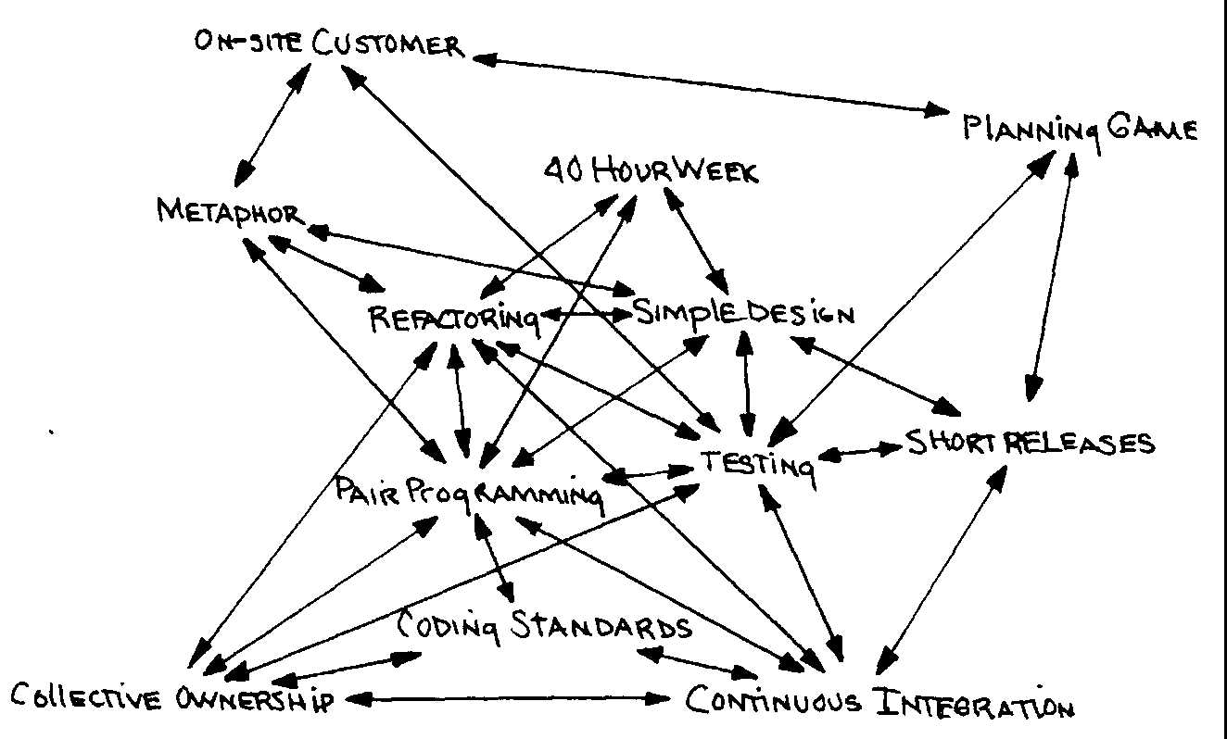
XP > 12 Practices > Synergy
XP says: practices will fail individually but will work synergistically ^{[1]}
Tools Available
Simulations Available

Slide 29
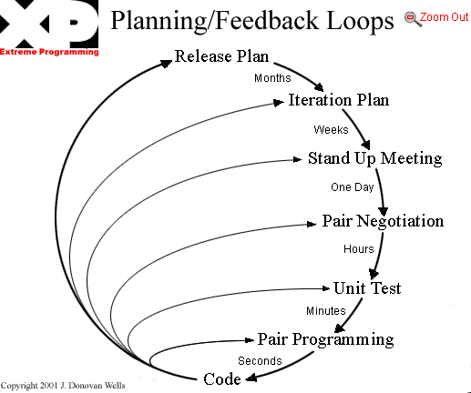
XP > Pros > Feedback Loops ^{[9]}

Slide 30
XP > Pros
Extreme = Continuous…
  Code reviews (pair programming)
  Unit testing
  Integration testing
  User acceptance testing
Can you keep the customer happy with constant feedback, communication, and simplicity?
Feedback through estimation, testing, short releases
  Gives user confidence
  Gives developers confidence
  Gives Management confidence
  Prototype & build (blatant iterative process)

Slide 31
XP > Pros
If design is good, why not make it everyone’s job? (refactoring)
If simplicity is good, why not use the simplest design that supports the current desired functionality? (simple design)
If architecture is good, why not have everyone work at defining and refining the architecture continuously? (metaphor)
If short iterations are good, why not make iterations really short (hours and days) instead of weeks and months? (short iterations & planning game)

Slide 32
XP > Pros
If code reviews are good, why not do it all the time? (pair programming)
If testing is good, why not do it all the time…even customers? (continuous unit and functional testing)
If integration testing is good, why not do it several times a day? (continuous integration)

Slide 33
XP > Limitations
XP is NOT a silver bullet!
May not work for
  Teams over 30
  Distributed teams
  Complex systems
  Integrating legacy code
  “Big M” organizations where methodology is rigid
  Burn-out organizations
    Where the more time you spend at work, the more valuable you are to the company
  Big ego developers
  Wrong physical environment
But it can be adapted

Slide 34
XP > Cons
Cultural shift can be difficult for Developers and Managers:
  Minor Culture Shift: Sustainable Pace, Coding Standards, Testing, Refactoring
  Major Culture Shift: On-Site Customer, Planning Game, Small Releases, Simple Design
  Extreme Culture Shift: Collective Ownership, Pair Programming, Metaphor
Requires experienced OO developers (but not gurus)
May not get a “customer” on-site
  May not get all of their time
  May not be a decision maker
  May break the internal culture

Slide 35
XP > FAQs
Documentation?
  Code is the documentation (if conform to coding standards)
  Other documentation as needed
Does XP work with UML?
  Use it if it makes sense for your customer/project
  Don’t let “pictures” and models bog you down
  See “Agile Modeling” ^{[13]}
Does XP work within context of CMM?
  XP practices can map to CMM processes ^{[10,11]}

Slide 36
XP > FAQs
Metrics
  There are several to choose from
  The key is to make them visible
  (“The Big Visible Chart”)
Prototypes?
  XP calls them “spikes”
  Treat it as a story for an iteration
Bug fixes?
  Also can be treated as a story for an iteration

Slide 37
Future of XP?
Conferences
  OOPSLA
  http://www.xpuniverse.com
    Now becoming “XP Agile Universe”
  Numerous others
Convergence? Evolution?

Slide 38
Agile is NOT JUST Extreme Programming
Agile Software Methodology Alliance
  http://www.agilealliance.org
  Representatives from Extreme Programming, SCRUM, DSDM, ASD-Crystal, Feature-Driven Development, Pragmatic Programming
  Recogize a need for an alternative to documentation-driven, heavyweight software development processes which doesn’t work for ALL projects
  Alliance formed Feb 2001
  Similar to merging of Booch, OMT, and others into UML?

Slide 39
FINIS
Comments?
Questions?
References (see last slides)
For more info, check out…
The Central Florida Patterns Group
http://groups.yahoo.com/group/cflpatternsgroup/

Slide 40
Contacting the Speakers
Mark Kilby / SAIC
  kilbym@saic.com / kilby@computer.org
Steve Raulerson / CONVERGYS
  steve.raulerson@convergys.com
Matt Weber / CONVERGYS
  matt.weber@convergys.com

Slide 41
Agile/XP Methodology References
Beck, Kent. “Extreme Programming explained”, 2000
Fowler, Martin. “The New Methodology”. Nov 2001. An overview of Agile Methodologies with brief descriptions of specific methodologies. http://www.martinfowler.com/articles/newMethodology.html
Jefferies, Ron. “They’re called practices for a reason”, Sept 2000. http://www.xprogramming.com/xpmag/PracticesForaReason.htm
Jefferies, Ron. “Circle of Life, Spiral of Death: Ways to Keep your XP Project Alive. Ways to Kill Your XP Project”. Invited Talk. XPUniverse, July 2001. Raleigh, NC
http://www.junit.org - testing frameworks
http://www.refactoring.org
Fowler, Martin. Refactoring: Improving the Design of Existing Code. Addison-Wesley. 2000

Slide 42
Agile/XP Methodology References
http://www.pairprogramming.com – many resources
http://www.extremeprogramming.org - Live methodology manual like RUP
http://www.xprogramming.org - many excellent articles from Ron Jefferies and others
Paulk, Mark (SEI). “XP from a CMM Perspective”. Invited Talk. XPUniverse, July 2001. Raleigh, NC.
http://c2.com/cgi/wiki?ExtremeProgrammingRoadmap - The Extreme Programming Roadmap on the Portland Pattern Repository. Where most of the discussions and good information take place in Wiki-style.
http://www.agilemodeling.com – Scott Ambler’s site with information on forthcoming book.
http://www.agilealliance.org - Non-profit organization dedicated to promote agile methodologies

